Slide 1


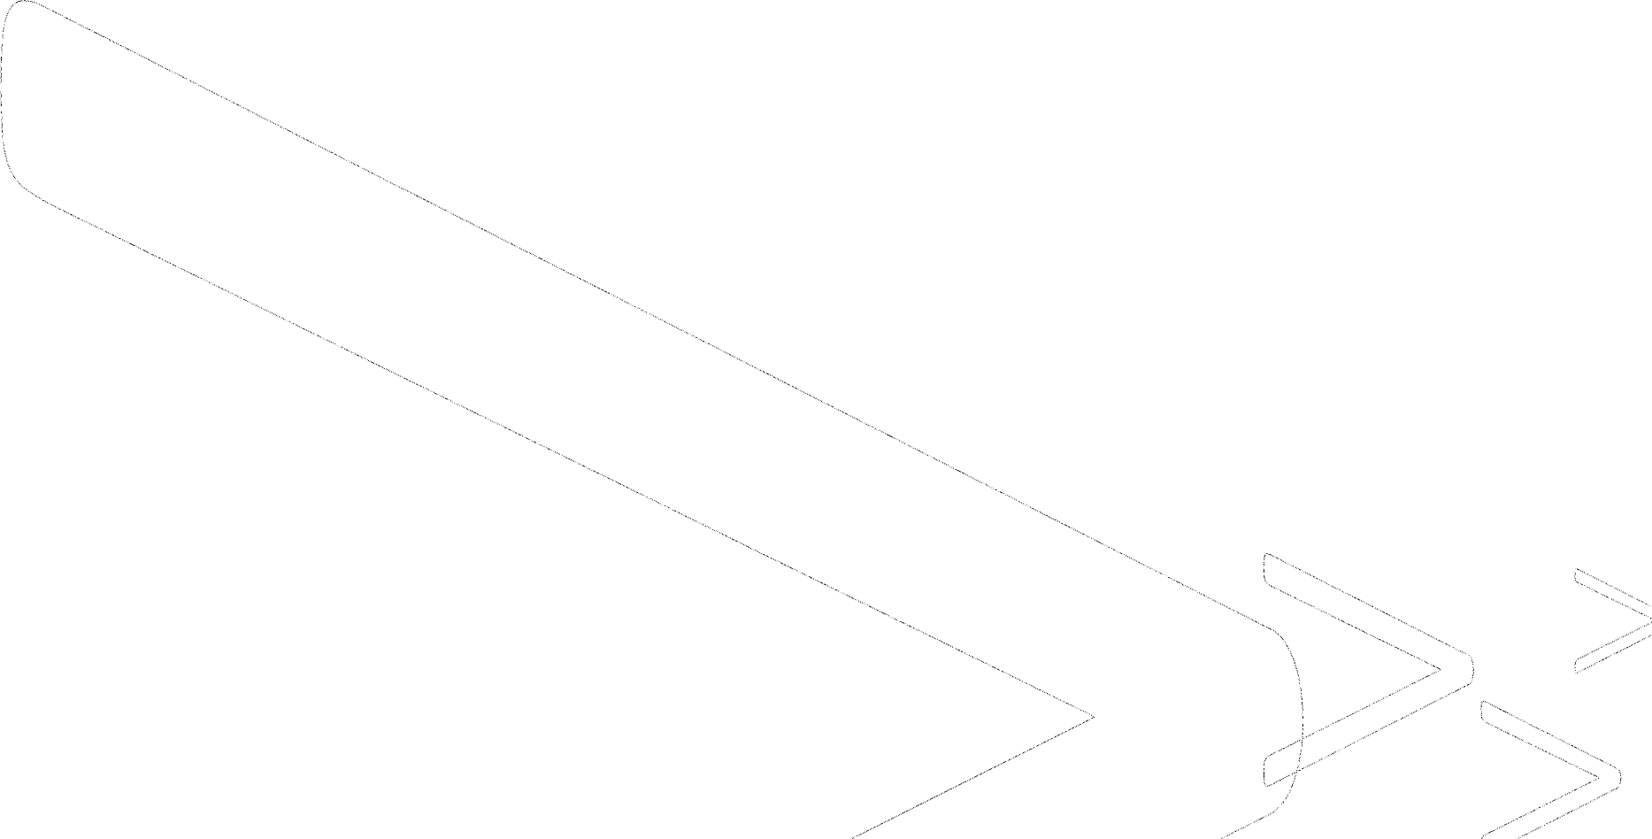
Mid-Evaluation Report
IITISOC’24 IVR3:
Micromouse
◤

Slide 2
Contents
◤
Exploring an array of algorithms
Micromouse Maze Simulator
Analysing different algorithms
Programs of different algorithms
Comparison (Pros & Cons)
Best algorithm
Bibliography

Slide 3
Exploring an array of algorithms
◤
Micromouse competitions demand efficient maze navigation.
To achieve this, various maze solving algorithms are employed. Some common algorithms include: Wall follower, DFS (Depth-First Search), BFS (Breadth- First Search), Dijkstra’s algorithm, Flood Fill algorithm, Tremaux algorithm, A* Search algorithm etc.
A thorough analysis will be conducted to identify the most suitable approach for our micromouse robot depending on the specific maze characteristics and desired robot behavior.

Slide 4
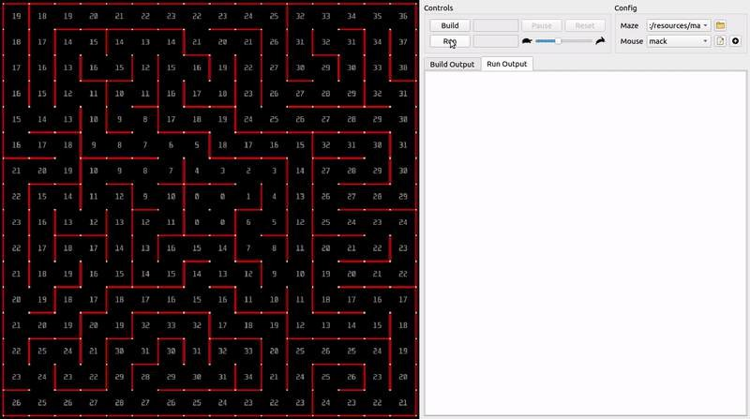
Micromouse Maze Simulator
◤
mms is a Micromouse simulator.
It makes it easy to write and test maze-solving code without a physical robot.
With it, you can:
Test how your robot would behave in a real
maze
Visualize what your robot is thinking:
Show known/unknown walls
Set the color of the cells
Display ASCII text on the cells
Simulate a crash-and-reset scenario
Test your algorithm on custom
maze files
Write code in any language you want

Slide 5
Analysing Different Algorithms
◤
BFS (Breadth-First Search) Algorithm
Start Cell : The Breadth-First Search (BFS) algorithm
begins at a designated starting cell within the maze.
Immediate Surroundings : All the connected paths directly next to the starting node are identified.
Systematic Exploration : BFS prioritizes exploring these neighboring paths first, adding them to a waiting list in the order they are discovered.
Level-by-Level Check : The algorithm then systematically removes and explores each path from the waiting list, one at a time.
Neighbors of Neighbors : While exploring a path, any new, unvisited connections branching out from it are added to the waiting list.
Expanding the Search : This process creates a widening search area, ensuring all paths at a specific distance from the starting node are explored before moving on.
Goal Check : During exploration, if a path leads to the designated end point (goal node) of the maze, the search concludes successfully.
Continuing the Search : If the goal isn't found on the current path, the algorithm removes and explores the next path from the waiting list, repeating previous steps.
Exhaustive Search : This process continues until all paths
within exploration range have been examined.
Finding a Solution : If the waiting list becomes empty without encountering the goal, the algorithm determines there's no accessible path to the goal from the starting point.

Slide 6
2) DFS (Depth First Search) Algorithm
Start Cell : DFS begins at a designated "start node" within the maze (graph).
Go Deep : Instead of checking all neighboring paths first (like BFS), DFS chooses one path and follows it as far as it can go.
Dead End? No Problem : If the chosen path reaches a dead end (unconnected node), DFS doesn't backtrack immediately.
Mark and Remember : It simply marks the dead end as visited and remembers it explored that branch.
Backtrack and Explore : Then, DFS backtracks to the most recent node with unexplored paths and continues following a new unvisited branch from there.
Repeat the Process : This process of going deep into a path, hitting a dead end, backtracking, and exploring a new branch continues until the goal is found or all possibilities are exhausted.
Finding the Exit : If DFS follows a path that luckily leads to the designated end point (goal node), the search concludes successfully.
No Way Out : If all paths from the starting node have been explored (dead ends or looped back to visited nodes), DFS determines there's no accessible path to the goal from that starting point.
Fast, But Not Guaranteed : DFS can be very quick at finding a solution if the goal happens to be along a direct path from the start. However, it doesn't guarantee finding the shortest path and might revisit explored areas if not careful.

Slide 7
3) Dijkstra’s Algorithm
Weighted Map : Dijkstra's algorithm treats the maze (graph) like a map where paths have "distances" instead of just connections. These distances could represent time, difficulty, or any relevant measure.
Starting Point : Similar to BFS, we begin at a designated "start node" within the maze.
Estimating Distances : Dijkstra’s estimates the most promising path towards the goal. It assigns a temporary “tentative distance” to the start node
Update Neighbors : Once a current node is chosen, Dijkstra's algorithm considers all its unvisited neighbors. It compares the existing tentative distances of these neighbors to the distance it took to reach the current node plus the distance of the connecting path.
Re-evaluating Paths : If the new calculated distance is shorter, the tentative distance for that neighbor is updated. This ensures we prioritize exploring paths that seem most likely to lead to the goal quickly.
Goal Reached : If the current node happens to be the goal node (the exit), the search stops successfully, and we have the shortest path based on the chosen distance measure.
(usually 0) and calculates tentative distances for all its ▪
neighboring nodes.
Keeping Track : These tentative distances and the corresponding nodes are stored in a data structure for easy reference.
Exploring the Best Option : The algorithm constantly seeks the unvisited node with the shortest tentative distance from the start. This becomes the “current node”

Slide 8
4) A* Search Algorithm
Informed Search : A* builds on the idea of Dijkstra's by incorporating an extra layer of information. It considers both the actual distance traveled (like Dijkstra's) and an estimate of the remaining distance to the goal.
Heuristic Help : This estimate, called a heuristic, guides the search towards more promising paths. The heuristic function needs to be admissible (never overestimate the remaining distance).
Evaluation Function : A* combines the actual distance traveled (g(n)) with the heuristic estimate (h(n)) to create a total score (f(n) = g(n) + h(n)) for each node.
Prioritizing Exploration : Similar to Dijkstra's, A* prioritizes exploring the unvisited node with the lowest f(n) score. This balances considering past travel distance with the potential remaining distance to the goal.
Updating Scores : As the search progresses, A* continuously updates g(n) values based on actual distances traveled and h(n) estimates based on the node's position relative to the goal.
Goal Achieved : If the current node with the lowest f(n) happens to be the goal node, the search stops successfully, and we likely have a near-optimal path (depending on the heuristic).
Continuing the Search (Optional) : A* can keep exploring even after finding a path, ensuring it discovers good paths to all reachable nodes.
Trade-Offs : A* prioritizes finding a solution quickly, sacrificing optimality compared to Dijkstra's in some cases. However, for complex mazes with good heuristics, it often finds very close-to-optimal paths.

Slide 9
5) Flood Fill Algorithm
Iterative Update s : Repeat the distance updating process for all cells until no more updates are needed, ensuring all reachable cells have the correct minimum distance values.
Pathfinding from Start : Starting from the mouse's initial position, always move to the neighboring cell with the smallest distance value, effectively following the shortest path.
Dynamic Adaptability : The flood fill algorithm can adapt to changes in the maze, such as new walls or opened paths, by recalculating distances as needed.
Algorithm Efficiency : While the flood fill algorithm is computationally efficient in finding the shortest path, it requires sufficient memory to store distance values for each cell, making it suitable for grids of manageable size.
Return Trip : While it does not guarantee finding the shortest path, it takes a different path to reach the initial position. This almost certainly would mean that the mouse had found the shortest path.
Grid Representation : Represent the maze as a grid where each cell can be either open (accessible) or blocked (wall), creating a matrix structure.
Goal Initialization : Set the distance value of the goal
cell to 0, indicating it is the target location.
Other Cells Initialization : Assign an initial distance value of infinity (or a large number) to all other cells, signifying they are initially unreachable.
Propagation Start : Begin the flood fill algorithm from the goal cell, spreading outwards to cover the entire grid.
Distance Update Rule : For each cell being processed, calculate and update the distances of its neighboring cells (up, down, left, right).
Neighbor Distance Check : If a neighboring cell's distance is greater than the current cell's distance plus one, update the neighboring cell's distance to the current cell's distance plus one.

Slide 10
Programs of Different Algorithms
◤
1) DFS
if nextX < currentX:
ancestors[neighbor] = current
if maze.inCenter(neighbor): center = neighbor
# If a center cell was found, stop searching
if center:
break
nextDirection = Direction.WEST
if nextY < currentY:
import API
nextDirection = Direction.SOUTH
import collections
if nextX > currentX:
import time
nextDirection = Direction.EAST
if nextY > currentY:
from Direction import Direction
nextDirection = Direction.NORTH
# Walk backwards from the center
from Maze import Maze
position = center
while ancestors[position] != initial:
position = ancestors[position]
# API.log(position)
from Mouse import Mouse
# Turn and move to the next cell
currentDirection = mouse.getDirection()
def main():
if currentDirection.turnLeft() == nextDirection:
begin = time.time()
mouse.turnLeft()
return position
maze = Maze(API.mazeWidth(), API.mazeHeight())
elif currentDirection.turnRight() == nextDirection:
def getNeighbor(current, direction):
mouse = Mouse(0, 0, Direction.NORTH)
mouse.turnRight()
x, y = current
while not maze.inCenter(mouse.getPosition()):
elif currentDirection != nextDirection:
if direction == Direction.NORTH:
updateWalls(maze, mouse)
mouse.turnAround()
moveOneCell(maze, mouse)
mouse.moveForward()
y += 1
end = time.time()
if direction == Direction.EAST:
time.sleep(1)
def getNextCell(maze, mouse):
x += 1
API.log(end-begin)
initial = mouse.getPosition()
if direction == Direction.SOUTH:
walls = []
center = None
y -= 1
def updateWalls(maze, mouse):
ancestors = {}
if direction == Direction.WEST:
position = mouse.getPosition()
queue = collections.deque([initial])
x -= 1
direction = mouse.getDirection()
while queue:
return (x, y)
if API.wallFront():
current = queue.popleft()
maze.setWall(position, direction)
for direction in Direction:
if name == " main ":
walls.append([position, direction])
neighbor = getNeighbor(current, direction)
main()
if API.wallLeft():
# If the neighbor is out of bounds, skip
maze.setWall(position, direction.turnLeft())
if not maze.contains(neighbor):
walls.append([position, direction.turnLeft()])
continue
if API.wallRight():
# If the neighbor is blocked by wall, skip
maze.setWall(position, direction.turnRight())
if maze.getWall(current, direction):
walls.append([position, direction.turnRight()])
continue
# If the neighbor is already discovered, skip
if neighbor in ancestors:
def moveOneCell(maze, mouse):
continue
# Compute the next direction
currentX, currentY = mouse.getPosition()
# Add the neighbor to queue and update ancestors
# API.log(neighbor)
nextX, nextY = getNextCell(maze, mouse)
queue.append(neighbor)

Slide 11
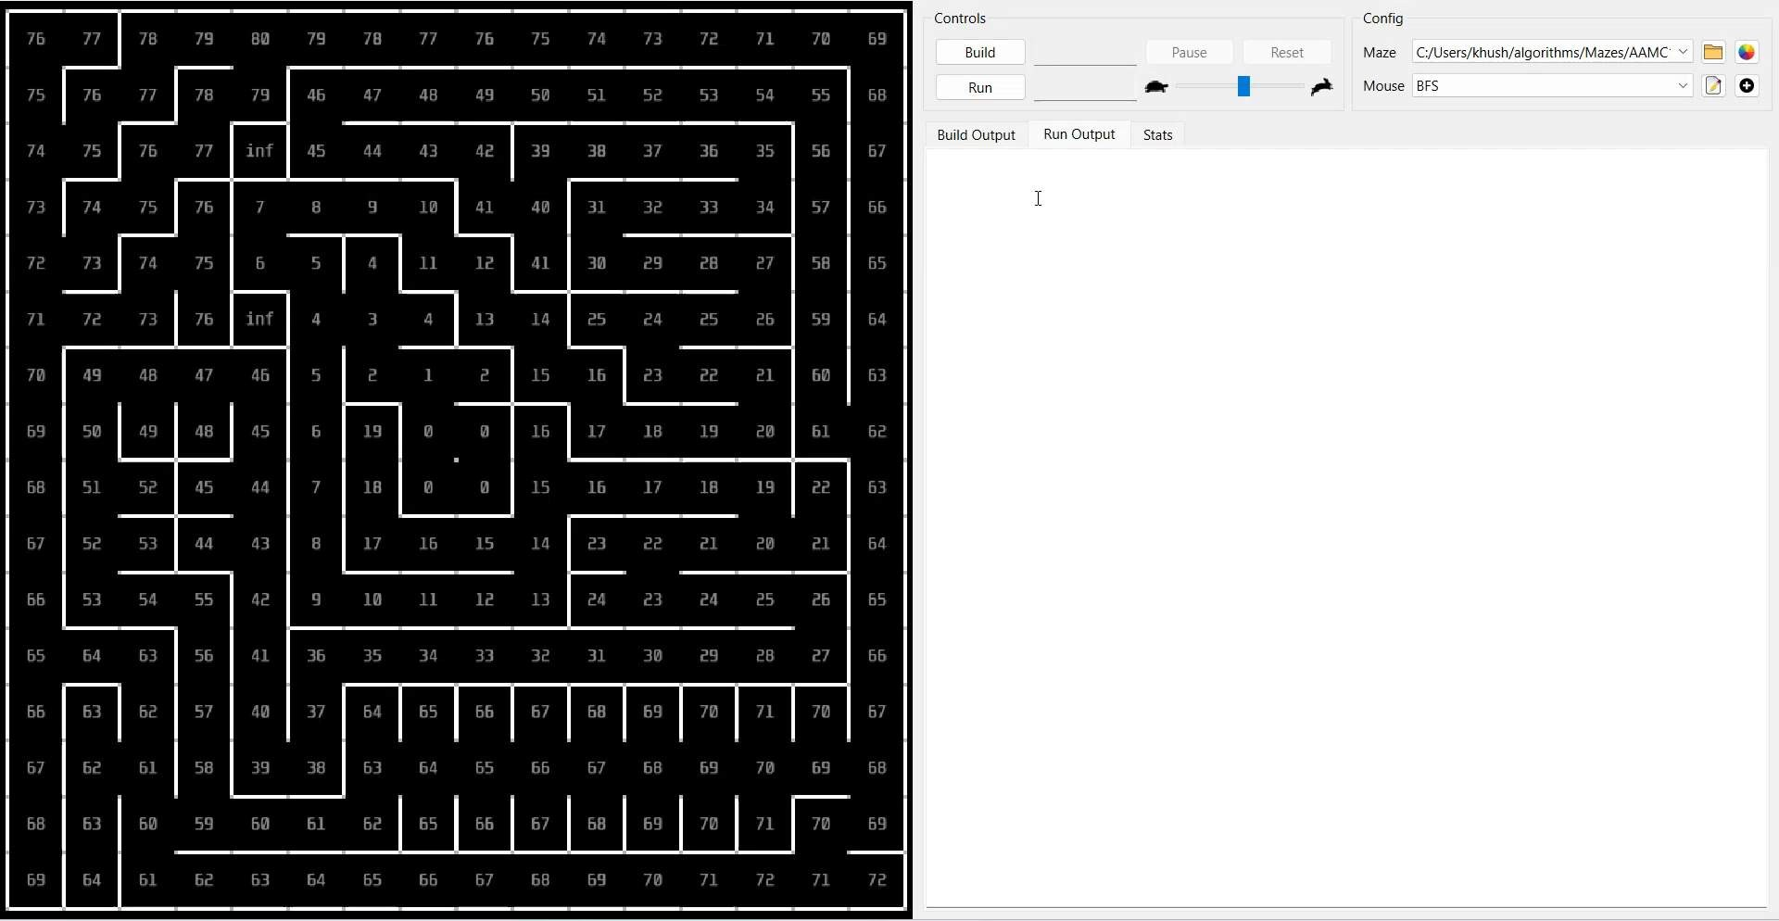
Simulation:

Slide 12
2) Dijkstra’s
◤
import API
path = []
def updateWalls(maze, mouse):
import heapq
current = goal
position = mouse.getPosition()
import time
while current != start:
direction = mouse.getDirection()
from Direction import Direction
path.append(current)
# Update walls based on sensor information
from Maze import Maze
current = parents[current]
if API.wallFront():
from Mouse import Mouse
path.append(start)
maze.setWall(position, direction)
class Cell:
path.reverse()
if API.wallLeft():
def init (self, x, y, cost):
return path
maze.setWall(position, direction.turnLeft())
self.x = x
def getNeighbor(current, direction):
x, y = current
if direction == Direction.NORTH:
y += 1
if API.wallRight():
self.y = y
maze.setWall(position, direction.turnRight())
self.cost = cost
def moveOneCell(maze, mouse):
def lt (self, other):
currentX, currentY = mouse.getPosition()
return self.cost < other.cost
elif direction == Direction.EAST:
next_cell = getNextCell(maze, mouse)
def dijkstra(maze, start, goal):
x += 1
nextX, nextY = next_cell
pq = []
elif direction == Direction.SOUTH:
direction = getDirection(currentX, currentY, nextX, nextY)
heapq.heappush(pq, Cell(start[0], start[1], 0))
y -= 1
current_direction = mouse.getDirection()
visited = set()
elif direction == Direction.WEST:
parents = {}
x -= 1
if current_direction.turnLeft() == direction:
costs = {start: 0}
return (x, y)
mouse.turnLeft()
while pq:
def getNextCell(maze, mouse):
elif current_direction.turnRight() == direction:
cell = heapq.heappop(pq)
current = mouse.getPosition()
mouse.turnRight()
x, y = cell.x, cell.y
center = (7,8) # Goal is to reach the maze center
elif current_direction != direction:
path = dijkstra(maze, current, center)
mouse.turnAround()
if (x, y) == goal:
mouse.moveForward()
break
if len(path) > 1:
return path[1] # Next cell to move towards
else:
return current # Stay in place if already at center or no valid path found
def getDirection(currentX, currentY, nextX, nextY):
if (x, y) in visited:
if nextX < currentX:
continue
return Direction.WEST
visited.add((x, y))
elif nextX > currentX:
def main():
return Direction.EAST
current_cost = costs[(x, y)]
begin = time.time()
elif nextY < currentY:
for direction in Direction:
maze = Maze(API.mazeWidth(), API.mazeHeight()) # Initialize maze dimensions using
return Direction.SOUTH
nx, ny = getNeighbor((x, y), direction)
API
elif nextY > currentY:
if not maze.contains((nx, ny)) or maze.getWall((x, y), direction) or (nx,
mouse = Mouse(0, 0, Direction.NORTH) # Initialize mouse at starting position
else:
return Direction.NORTH
ny) in visited:
start = (0, 0) # Starting position
return None # Should not happen in a valid pathfinding scenario
continue
while not maze.inCenter(mouse.getPosition()):
new_cost = current_cost + 1 # Assuming each step has a uniform cost of 1
updateWalls(maze, mouse)
if name == " main ":
if (nx, ny) not in costs or new_cost < costs[(nx, ny)]:
costs[(nx, ny)] = new_cost
parents[(nx, ny)] = (x, y)
heapq.heappush(pq, Cell(nx, ny, new_cost))
moveOneCell(maze, mouse)
main()
end = time.time()
time.sleep(1)
# Reconstruct path from goal to start
API.log(end - begin)

Slide 13
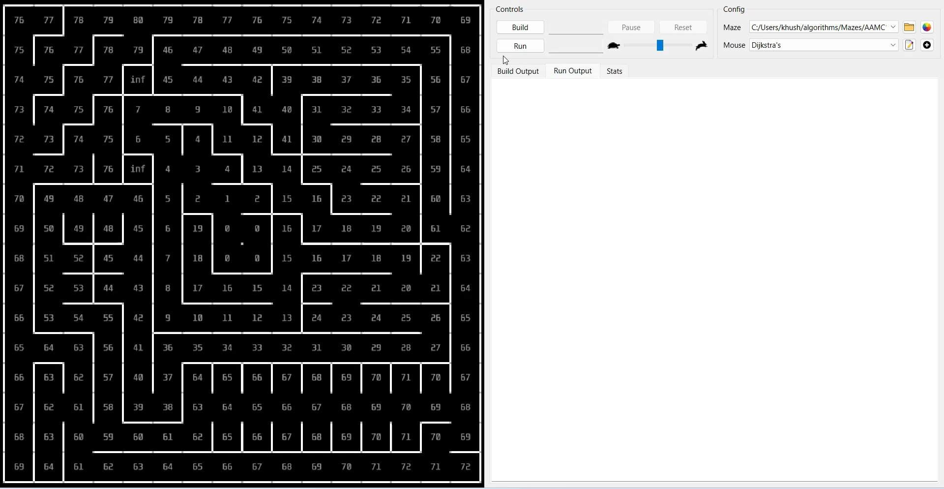
Simulation:

Slide 14
3) A*
◤
import API
elif currentDirection != nextDirection:
tentative_g_score = g_score[current] + 1 # assume cost of moving to
import collections
mouse.turnAround()
neighbor is 1
import time
mouse.moveForward()
if neighbor not in g_score or tentative_g_score < g_score[neighbor]:
import heapq
def getDirection(currentX: int, currentY: int, nextX: int, nextY: int) ->
came_from[neighbor] = current
from Direction import Direction
Direction:
g_score[neighbor] = tentative_g_score
from Maze import Maze
if nextX < currentX:
f_score[neighbor] = tentative_g_score + heuristic(neighbor,
from Mouse import Mouse
return Direction.WEST
goal_cells[0])
from typing import Tuple, Dict, List
elif nextY < currentY:
if neighbor not in [i[1] for i in open_set]:
def main():
return Direction.SOUTH
heapq.heappush(open_set, (f_score[neighbor], neighbor))
begin = time.time()
elif nextX > currentX:
def heuristic(cell: Tuple[int, int], goal: Tuple[int, int]) -> int:
maze = Maze(API.mazeWidth(), API.mazeHeight())
return Direction.EAST
return abs(cell[0] - goal[0]) + abs(cell[1] - goal[1]) # Manhattan distance
mouse = Mouse(0, 0, Direction.NORTH)
elif nextY > currentY:
while not maze.inCenter(mouse.getPosition()):
return Direction.NORTH
def reconstruct_path(came_from: Dict[Tuple[int, int], Tuple[int, int]], current:
updateWalls(maze, mouse)
def getNextCell(maze: Maze, mouse: Mouse) -> Tuple[int, int]:
Tuple[int, int], start: Tuple[int, int]) -> Tuple[int, int]:
moveOneCell(maze, mouse)
initial = mouse.getPosition()
while came_from[current] != start:
end = time.time()
goal_cells = [(API.mazeWidth() // 2, API.mazeHeight() // 2)]
current = came_from[current]
time.sleep(1)
if API.mazeWidth() % 2 == 0:
return current
API.log(end - begin)
goal_cells.append((API.mazeWidth() // 2 - 1, API.mazeHeight() // 2))
def updateWalls(maze: Maze, mouse: Mouse):
goal_cells.append((API.mazeWidth() // 2, API.mazeHeight() // 2 - 1))
def getNeighbor(current: Tuple[int, int], direction: Direction) -> Tuple[int,
position = mouse.getPosition()
goal_cells.append((API.mazeWidth() // 2 - 1, API.mazeHeight() // 2 - 1))
int]:
direction = mouse.getDirection()
open_set = []
x, y = current
if API.wallFront():
heapq.heappush(open_set, (0, initial))
if direction == Direction.NORTH:
maze.setWall(position, direction)
came_from: Dict[Tuple[int, int], Tuple[int, int]] = {}
y += 1
if API.wallLeft():
g_score: Dict[Tuple[int, int], int] = {initial: 0}
elif direction == Direction.EAST:
maze.setWall(position, direction.turnLeft())
f_score: Dict[Tuple[int, int], int] = {initial: heuristic(initial,
x += 1
if API.wallRight():
goal_cells[0])}
elif direction == Direction.SOUTH:
maze.setWall(position, direction.turnRight())
y -= 1
while open_set:
elif direction == Direction.WEST:
def moveOneCell(maze: Maze, mouse: Mouse):
_, current = heapq.heappop(open_set)
x -= 1
currentX, currentY = mouse.getPosition()
return (x, y)
nextX, nextY = getNextCell(maze, mouse)
if maze.inCenter(current):
if name == " main ":
nextDirection = getDirection(currentX, currentY, nextX, nextY)
return reconstruct_path(came_from, current, initial)
main()
currentDirection = mouse.getDirection()
for direction in Direction:
if currentDirection.turnLeft() == nextDirection:
mouse.turnLeft()
elif currentDirection.turnRight() == nextDirection:
mouse.turnRight()
neighbor = getNeighbor(current, direction)
if not maze.contains(neighbor) or maze.getWall(current, direction):
continue

Slide 15
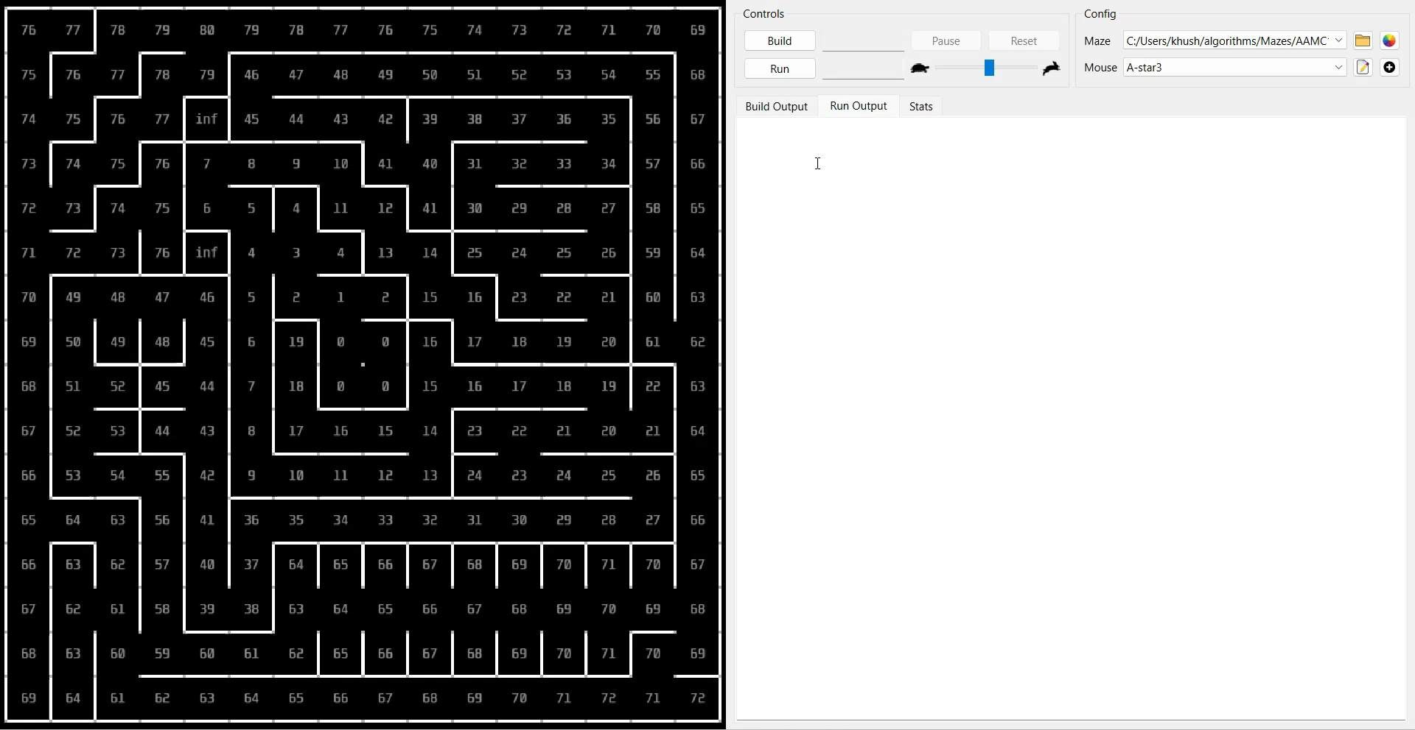
Simulation:

Slide 16
4) Flood Fill
◤
import API
import time
for direction in Direction:
# Calculate Manhattan distances using flood fill from the goal cells
from Direction import Direction
neighbor = getNeighbor(current_position, direction, maze)
distances = floodFillManhattanDistances(maze, goal_cells)
from Maze import Maze
if maze.contains(neighbor) and not maze.getWall(current_position, direction) and neighbor
from Mouse import Mouse
not in visited and distances[neighbor[0]][neighbor[1]] != None:
visited = set() # Set to keep track of visited cells
from collections import deque
if distances[neighbor[0]][neighbor[1]] < min_distance:
min_distance = distances[neighbor[0]][neighbor[1]]
next_direction = direction
next_position = neighbor
visited.add(start) # Mark the starting cell as visited
def floodFillManhattanDistances(maze, goals):
while not maze.inCenter(mouse.getPosition()):
width = API.mazeWidth()
updateWalls(maze, mouse)
height = API.mazeHeight()
distances = floodFillManhattanDistances(maze, goal_cells)
distances = [[None] * height for _ in range(width)]
if next_position:
# API.log(distances)
queue = deque([(goal[0], goal[1], 0) for goal in goals]) # Using deque for efficient pop from
while current_direction != next_direction:
moved = moveTowardsSmallestDistance(maze, mouse, distances, visited, goal_cells)
the front
if current_direction.turnLeft() == next_direction:
if not moved:
visited = set()
distances = floodFillManhattanDistances(maze, goal_cells)
moved = moveTowardsSmallestDistance(maze, mouse, distances, visited, goal_cells)
for goal in goals:
mouse.turnLeft()
distances[goal[0]][goal[1]] = 0
elif current_direction.turnRight() == next_direction:
while queue:
else:
mouse.turnRight()
x, y, dist = queue.popleft() # pop from the front of the deque
mouse.turnAround()
end = time.time()
for direction in Direction:
distances = floodFillManhattanDistances(maze, goal_cells)
time.sleep(1)
if maze.getWall((x, y), direction):
current_direction = mouse.getDirection()
API.log("Maze solved in {:.2f} seconds".format(end - begin))
# if x !=0 and x!=15 and y!=0 and y!=15:
def updateWalls(maze, mouse):
#
API.log(f'continued at {x},{y} in drin {direction}')
mouse.moveForward()
position = mouse.getPosition()
else:
continue
current_position = mouse.getPosition()
direction = mouse.getDirection()
nx, ny = getNeighbor((x, y), direction, maze)
visited.add(current_position) # Update visited set with the new position
# API.setText(nx,ny,f'{maze.getWall((x, y), direction)}') if maze.contains((nx, ny)) and distances[nx][ny] == None:
return True # Successfully moved
# Update walls based on sensor information
def getDirection(current, target):
if API.wallFront():
distances[nx][ny] = dist + 1
cx, cy = current
maze.setWall(position, direction)
# API.setText(nx,ny,f'{distances[nx][ny]}')
tx, ty = target
if API.wallLeft():
# time.sleep(0.01*distances[nx][ny])
maze.setWall(position, direction.turnLeft())
queue.append([nx, ny, distances[nx][ny]])
if tx > cx:
return Direction.EAST
elif tx < cx:
return Direction.WEST
if API.wallRight():
return distances
maze.setWall(position, direction.turnRight())
if name == " main ":
def getNeighbor(current, direction, maze):
elif ty > cy:
main()
x, y = current
return Direction.NORTH
if direction == Direction.NORTH:
elif ty < cy:
y += 1
return Direction.SOUTH
elif direction == Direction.EAST:
else:
x += 1
return None
elif direction == Direction.SOUTH:
def main():
y -= 1
begin = time.time()
elif direction == Direction.WEST:
maze = Maze(API.mazeWidth(), API.mazeHeight()) # Initialize maze dimensions using API
x -= 1
mouse = Mouse(0, 0, Direction.NORTH) # Initialize mouse at starting position
return (x, y)
start = (0, 0) # Starting position
def moveTowardsSmallestDistance(maze, mouse, distances, visited, goal_cells):
# Define the goal cells (e.g., the center of the maze)
current_position = mouse.getPosition()
goal_cells = [(API.mazeWidth() // 2, API.mazeHeight() // 2)]
current_direction = mouse.getDirection()
if API.mazeWidth() % 2 == 0:
min_distance = float('inf')
goal_cells.append((API.mazeWidth() // 2 - 1, API.mazeHeight() // 2))
next_direction = None
goal_cells.append((API.mazeWidth() // 2, API.mazeHeight() // 2 - 1))
next_position = None
goal_cells.append((API.mazeWidth() // 2 - 1, API.mazeHeight() // 2 - 1))

Slide 17
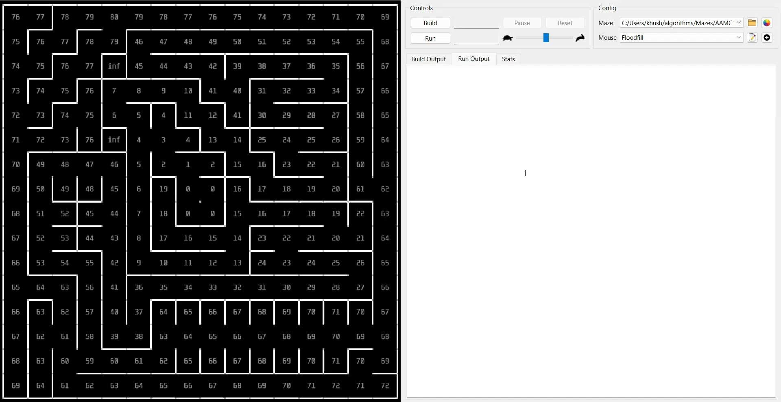
Simulation:

Slide 18
Flood Fill (With return trip)
◤
import API
if current_direction.turnLeft() == next_direction:
goal_cells.append((API.mazeWidth() // 2 - 1, API.mazeHeight() // 2 - 1))
import time
mouse.turnLeft()
# Calculate Manhattan distances using flood fill from the goal cells
from Direction import Direction
elif current_direction.turnRight() == next_direction:
distances = floodFillManhattanDistances(maze, goal_cells)
from Maze import Maze
mouse.turnRight()
from Mouse import Mouse
else:
visited = set() # Set to keep track of visited cells
from collections import deque
mouse.turnAround()
visited.add(start) # Mark the starting cell as visited
# distances = floodFillManhattanDistances(maze, goal_cells)
for i in range(3):
def floodFillManhattanDistances(maze, goals):
current_direction = mouse.getDirection()
while not maze.inCenter(mouse.getPosition()):
width = API.mazeWidth()
mouse.moveForward()
updateWalls(maze, mouse)
height = API.mazeHeight()
current_position = mouse.getPosition()
distances = floodFillManhattanDistances(maze, goal_cells)
distances = [[None] * height for _ in range(width)]
visited.add(current_position) # Update visited set with the new position
# API.log(distances)
queue = deque([(goal[0], goal[1], 0) for goal in goals]) # Using deque for efficient pop
return True # Successfully moved
moved = moveTowardsSmallestDistance(maze, mouse, distances, visited)
from the front
for goal in goals:
def getDirection(current, target):
if not moved:
distances[goal[0]][goal[1]] = 0
cx, cy = current
visited = set()
while queue:
tx, ty = target
distances = floodFillManhattanDistances(maze, goal_cells)
x, y, dist = queue.popleft() # pop from the front of the deque
if tx > cx:
moved = moveTowardsSmallestDistance(maze, mouse, distances, visited)
for direction in Direction:
return Direction.EAST
if i < 2:
if maze.getWall((x, y), direction):
elif tx < cx:
visited = set()
# if x !=0 and x!=15 and y!=0 and y!=15:
return Direction.WEST
while mouse.getPosition() != (0,0):
#
API.log(f'continued at {x},{y} in drin {direction}')
elif ty > cy:
updateWalls(maze, mouse)
continue
return Direction.NORTH
distances = moveToStart(maze)
else:
elif ty < cy:
moved = moveTowardsSmallestDistance(maze, mouse, distances, visited)
nx, ny = getNeighbor((x, y), direction, maze)
return Direction.SOUTH
if not moved:
# API.setText(nx,ny,f'{maze.getWall((x, y), direction)}')
else:
visited = set()
if maze.contains((nx, ny)) and distances[nx][ny] == None:
return None
distances = moveToStart(maze)
distances[nx][ny] = dist + 1
def moveToStart(maze):
moved = moveTowardsSmallestDistance(maze, mouse, distances, visited)
# API.setText(nx,ny,f'{distances[nx][ny]}')
width = API.mazeWidth()
end = time.time()
# time.sleep(0.01*distances[nx][ny])
height = API.mazeHeight()
time.sleep(1)
queue.append([nx, ny, distances[nx][ny]])
distances = [[None] * height for _ in range(width)]
API.log("Maze solved in {:.2f} seconds".format(end - begin))
return distances
queue = deque([(0, 0, 0)]) # Using deque for efficient pop from the front
def updateWalls(maze, mouse):
distances[0][0] = 0
position = mouse.getPosition()
# for x in range(16):
direction = mouse.getDirection()
def getNeighbor(current, direction, maze):
#
for y in range(16):
x, y = current
#
API.setText(x,y,f'{distances[x][y]}')
# Update walls based on sensor information
if direction == Direction.NORTH:
#
time.sleep(0.005)
if API.wallFront():
y += 1
while queue:
maze.setWall(position, direction)
elif direction == Direction.EAST:
x, y, dist = queue.popleft() # pop from the front of the deque
if API.wallLeft():
x += 1
for direction in Direction:
maze.setWall(position, direction.turnLeft())
elif direction == Direction.SOUTH:
if maze.getWall((x, y), direction):
if API.wallRight():
y -= 1
# if x !=0 and x!=15 and y!=0 and y!=15:
maze.setWall(position, direction.turnRight())
elif direction == Direction.WEST:
#
API.log(f'continued at {x},{y} in drin {direction}')
x -= 1
continue
if name == " main ":
return (x, y)
else:
main()
def moveTowardsSmallestDistance(maze, mouse, distances, visited):
nx, ny = getNeighbor((x, y), direction, maze)
current_position = mouse.getPosition()
# API.setText(nx,ny,f'{maze.getWall((x, y), direction)}')
current_direction = mouse.getDirection()
if maze.contains((nx, ny)) and distances[nx][ny] == None:
min_distance = float('inf')
distances[nx][ny] = dist + 1
next_direction = None
# API.setText(nx,ny,f'{distances[nx][ny]}')
next_position = None
# time.sleep(0.005*distances[nx][ny])
for direction in Direction:
queue.append([nx, ny, distances[nx][ny]])
neighbor = getNeighbor(current_position, direction, maze)
return distances
if maze.contains(neighbor) and not maze.getWall(current_position, direction) and neighbor ^{def main():}
not in visited and distances[neighbor[0]][neighbor[1]] != None:
begin = time.time()
if distances[neighbor[0]][neighbor[1]] < min_distance:
maze = Maze(API.mazeWidth(), API.mazeHeight()) # Initialize maze dimensions using API
min_distance = distances[neighbor[0]][neighbor[1]]
mouse = Mouse(0, 0, Direction.NORTH) # Initialize mouse at starting position
next_direction = direction
start = (0, 0) # Starting position
next_position = neighbor
# Define the goal cells (e.g., the center of the maze)
goal_cells = [(API.mazeWidth() // 2, API.mazeHeight() // 2)]
if API.mazeWidth() % 2 == 0:
if next_position:
goal_cells.append((API.mazeWidth() // 2 - 1, API.mazeHeight() // 2))
while current_direction != next_direction:
goal_cells.append((API.mazeWidth() // 2, API.mazeHeight() // 2 - 1))

Slide 19
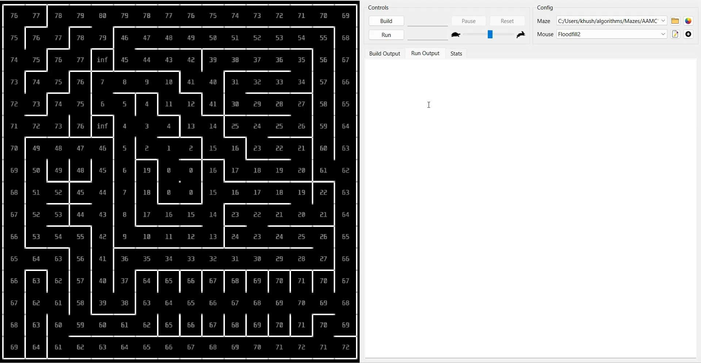
Simulation:

Slide 20
Comparison
Algorithm
Pros
Cons
◤
Not guaranteed to find the shortest path
Can get stuck in loops without proper handling
Inefficient for large mazes
Higher memory usage due to distance tracking
Slower compared to algorithms designed for specific goals Can be overkill for simple, unweighted mazes
Requires a good heuristic for optimal performance
Higher computational complexity compared to simpler
Can be complex to implement correctly High memory usage for large grids
Initial setup can be computationally intensive Not optimized for weighted mazes
DFS
Simple to implement
Low memory usage
Good for exploring all possible paths
Dijkstra’s
Guarantees the shortest path
Works well with weighted graphs Explores all possible paths evenly
A*
Efficiently finds the shortest path
Balances exploration and goal-directed search
Handles both weighted and unweighted mazes effectively
algorithms
Flood Fill
Guarantees the shortest path
Simple and intuitive to implement
Can handle dynamic changes in the maze

Slide 21


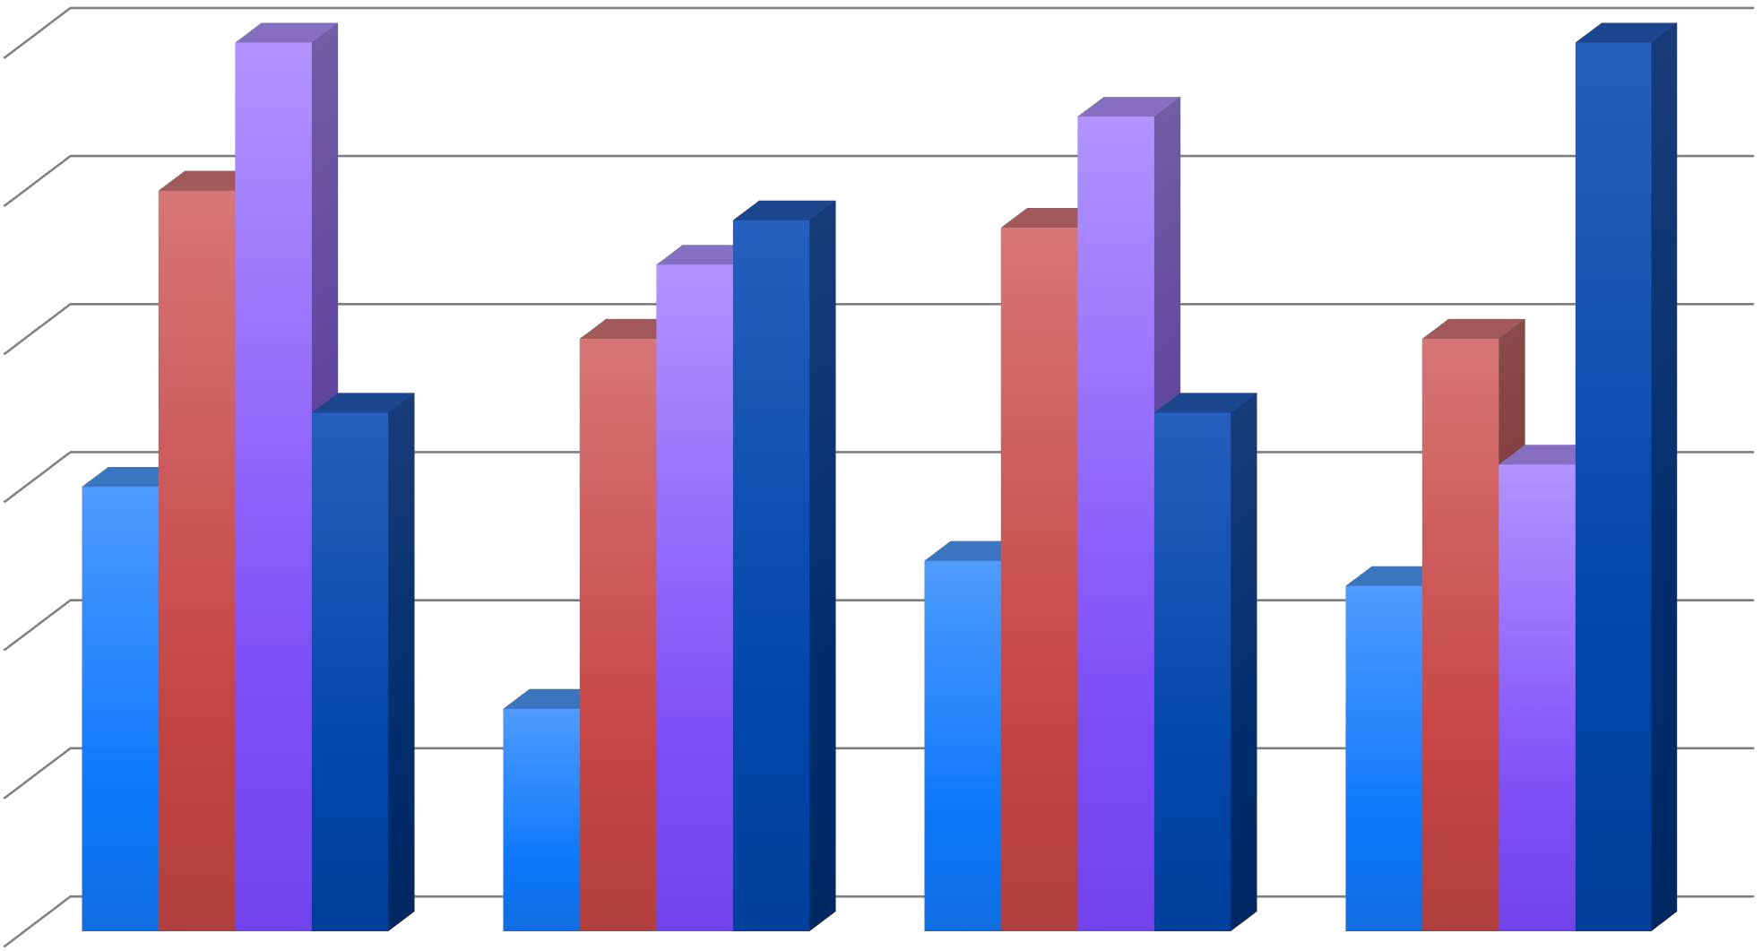
Efficiency based on our criteria
Complexity of Program
Shortest Path Guarantee
DFS Dijkstra's
Maze Searching Time
A* Flood Fill (With return trip)
Efficiency

Slide 22
Best Algorithm (According to our requirements)
◤
Guaranteed Shortest Path : Flood Fill ensures the shortest path is always found, unlike DFS which may not find the shortest path.
Simplicity in Implementation: Flood Fill is straightforward and easier to implement compared to the more complex A-star algorithm.
Dynamic Maze Adaptability: Flood Fill can handle dynamic changes in the maze, such as new walls or paths, without a complete re-run of the algorithm.
Unweighted Maze Efficiency: For unweighted mazes, Flood Fill is highly efficient, whereas Dijkstra's is more suited for weighted graphs, adding unnecessary complexity.
Memory Management: While Flood Fill requires memory to store distances, it avoids the deep recursion stack issues of DFS, making it more manageable for larger mazes.
Deterministic Behavior: Flood Fill provides consistent and predictable results, while DFS can vary greatly depending on the traversal order.
Uniform Exploration: Flood Fill explores the maze uniformly, ensuring no part of the maze is ignored, unlike DFS which might miss paths.
Goal-Oriented: Flood Fill is directly goal-oriented, spreading from the goal outwards, which can be more intuitive than the heuristic-based A-star.
Scalability: The Flood Fill algorithm scales well with maze size, maintaining performance where DFS can become inefficient and A-star can become computationally heavy.
No Heuristic Dependence: Flood Fill does not rely on heuristics, unlike A-star, which requires a good heuristic to function optimally, reducing the complexity of parameter tuning.

Slide 23
Bibliography
◤
https://youtu.be/ktn3C7aXVR0?feature=shared
https://github.com/mackorone/breadth-first-search
https://www.geeksforgeeks.org/dijkstras-shortest-path-algorithm-greedy-algo-7/
https://en.wikipedia.org/wiki/Dijkstra's_algorithm
https://www.geeksforgeeks.org/flood-fill-algorithm/
https://en.wikipedia.org/wiki/Dijkstra's_algorithm
https://en.wikipedia.org/wiki/Depth-first_search
https://www.geeksforgeeks.org/depth-first-search-or-dfs-for-a-graph/
https://en.wikipedia.org/wiki/Breadth-first_search
https://www.geeksforgeeks.org/breadth-first-search-or-bfs-for-a-graph/
https://en.wikipedia.org/wiki/A*_search_algorithm
https://www.geeksforgeeks.org/a-search-algorithm/
https://youtu.be/EPDAweXxKJ4?si=ESgo3BmEeuBTNCYC

